Slide 1
STUDENT MARKSHEET SYSTEM
Name: Nayana Jose (RA2111013010013) & Uma Harshini
(RA2111013010015)
Professor: Miss Hema M

Slide 2
INTRODUCTION
A Student Marksheet is usually used in schools, colleges and universities for storing the academic records of all students. All information regarding marks can be stored and different operations can be performed for retrieving the required data. The Student Marksheet System in C can be used to generate a student’s performance result. This system can help manage and generate the result for each student studying multiple subjects. The purpose of this system is to provide fair grading and accurate results.

Slide 3
ABSTRACT
STEP 1: The variable name and datatypes are declared.
STEP 2: The user should input the student name, roll no, class and the marks obtained in five subjects.
STEP 3: The total marks obtained and the percentage is calculated.
STEP 4: The grading and remarks is done by using the if, else if statements.
STEP 5:It is decided whether a student should write the supplementary exam or not.
STEP 6:The marksheet is printed.

Slide 4
CODE FOR THE PROGRAM
#include <stdio.h>
#include <string.h>
int main()
{
//CREATING A MARKSHEET IN C
//OBTAINED MARKS
//PERCENTAGE
//GRADE
//REMARKS
//SUPPLY OR FAIL
//variable declaration
char name[40], dept[40], section[40];
int rollno, math, biology, english, physics, chemistry, obtained, percentage;

Slide 5
//taking user details
printf("Enter Your Name: \n");
scanf("%s",&name);
printf("Enter Your Department: \n");
scanf("%s",&dept);
printf("Enter Your Roll No: \n");
scanf("%d",&rollno);
printf("Enter Your Section: \n");
scanf("%s",&section);
//taking user marks
printf("Enter math marks:\n");
scanf("%d",&math);
printf("Enter biology marks: \n");
scanf("%d",&biology);
printf("Enter english marks:\n");
scanf("%d",&english);
printf("Enter physics marks:\n");
scanf("%d",&physics);
printf("Enter chemistry marks:\n");
scanf("%d",&chemistry);

Slide 6
// calculating obtained marks and percentage
obtained= math+biology+english+physics+chemistry;
percentage= obtained*100/500;
// printing marksheet
printf("-------------------------MARKSHEET-------------------------- \n");
printf(“ SRM INSTITUTE OF SCIENCE AND TECHNOLOGY \n”);
printf("Your Name is %s \n",name);
printf("Your Department is %s \n",dept);
printf("Your Roll Number is %d \n",rollno);
printf("Your Section is %s \n",section);
printf("Your Obtained marks is %d \n",obtained);
printf("Your Percentage is %d \n",percentage);

Slide 7
//if else if for grade
if(percentage>=80)
{ printf("Grade: A-1 \n"); }
else if(percentage>=70)
{ printf("Grade:A \n"); }
else if(percentage>=60)
{ printf("Grade:B \n"); }
else if(percentage>=50)
{ printf("Grade:C \n"); }
else if(percentage>=40)
{ printf("Grade:D \n"); }
else if(percentage>=33)
{ printf("Grade:E \n"); }
else
{ printf("Grades:F -- Fail \n"); }

Slide 8
//if else if for remarks
if(percentage>=80)
{ printf("Remarks: Excellent \n"); }
else if(percentage>=70)
{ printf("Remarks: Very Good \n"); }
else if(percentage>=60)
{ printf("Remarks: Good \n"); }
else if(percentage>=50)
{ printf("Remarks: Average \n"); }
else if(percentage>=40)
{ printf("Remarks: Below Average \n"); }
else if(percentage>=33)
{ printf("Remarks: Needs improvement \n"); }
else
{ printf("Remarks: Not graded\n"); }

Slide 9
int supply = 0;
if(math<33)
{
printf("You have supply in math. \n");
//supply++;
}
if(biology<33)
{
printf("You have supply in biology. \n");
//supply++;
}
if(english<33)
{
printf("You have supply in English. \n");
//supply++;
}
if(physics<33)
{
printf("You have supply in physics. \n");
//supply++;
}

Slide 10
if(chemistry<33)
{
printf("You have supply in chemistry. \n");
//supply++;
}
//printf("You have %d supply.", supply);
}

Slide 11
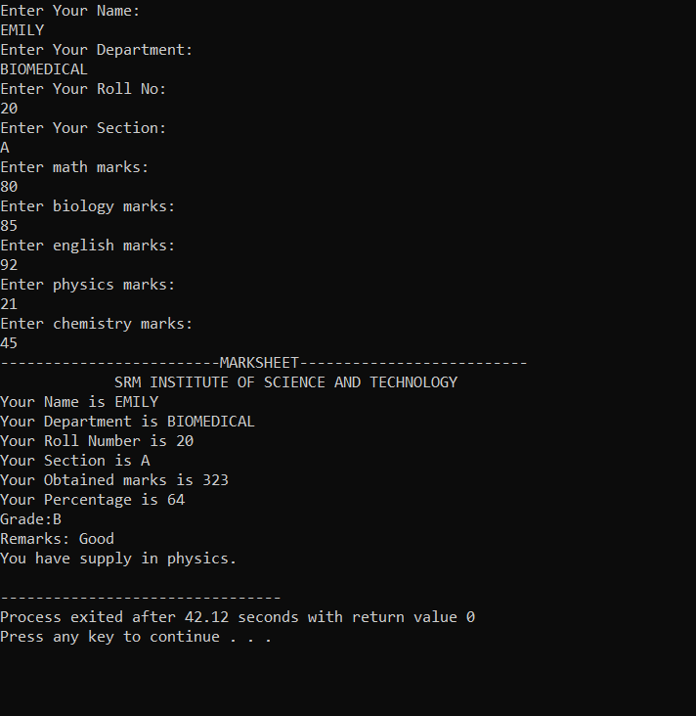
OUTPUT

Slide 12
EXPLANATION OF THE CODE
For creating a Student Marksheet using C program,
First we are declaring the following variables name, dept, rollno, standard, math, biology, english, physics, chemistry, obtained marks, percentage using the datatypes char and int.
Then the details are taken from the user.
The user must enter their Name, Department, Roll No, Class and the marks of the five subjects obtained.
After that, the total marks and percentage is calculated.
The total marks are calculated by adding all the five subjects.
The percentage is calculated by multiplying the total obtained marks by 100 and then dividing it by 500
Grades and remarks are given according to the percentage using if, else if statements.
Subjects having marks less than 33 are printed with supply(retest).
The marksheet is printed by giving the printf statements.
The entire student marksheet data is viewed at once.

Slide 13
THANK YOU

